Slide 1
A
Heart-Wrenching
Good-Bye
Luke 19:38
Sunday, March 29, 2015
Wayne Hartsgrove

Slide 2
³⁸ saying:
“ ‘Blessed is the King who comes in the name of the Lord!’ Peace in heaven and glory in the highest!”
Luke 19:38 (NKJV)

Slide 3
²⁸ And we know that all things work together for good to those who love God, to those who are the called according to His purpose. ²⁹ For whom He foreknew, He also predestined to be conformed to the image of His Son, that He might be the firstborn among many brethren.
Romans 8:28-29 (NKJV)

Slide 4
²⁸ When He had said this, He went on ahead, going up to Jerusalem. ²⁹ And it came to pass, when He drew near to Bethphage and Bethany, at the mountain called Olivet, that He sent two of His disciples, ³⁰ saying, “Go into the village opposite you, where as you enter you will find a colt tied, on which no one has ever sat. Loose it and bring it here.
Luke 19:28-30 (NKJV)

Slide 5
³¹ And if anyone asks you, ‘Why are you loosing it?’ thus you shall say to him, ‘Because the Lord has need of it.’”
Luke 19:31 (NKJV)

Slide 6
³² So those who were sent went their way and found it just as He had said to them. ³³ But as they were loosing the colt, the owners of it said to them, “Why are you loosing the colt?”
Luke 19:32-33 (NKJV)

Slide 7
³⁴ And they said, “The Lord has need of him.” ³⁵ Then they brought him to Jesus. And they threw their own clothes on the colt, and they set Jesus on him. ³⁶ And as He went, many spread their clothes on the road.
Luke 19:34-36 (NKJV)

Slide 8
³⁷ Then, as He was now drawing near the descent of the Mount of Olives, the whole multitude of the disciples began to rejoice and praise God with a loud voice for all the mighty works they had seen,
Luke 19:37 (NKJV)

Slide 9
³⁸ saying:
“ ‘Blessed is the King who comes in the name of the Lord!’ Peace in heaven and glory in the highest!”
Luke 19:38 (NKJV)

Slide 10
³⁹ And some of the Pharisees called to Him from the crowd, “Teacher, rebuke Your disciples.”
⁴⁰ But He answered and said to them, “I tell you that if these should keep silent, the stones would immediately cry out.”
Luke 19:39-40 (NKJV)

Slide 11
⁴¹ Now as He drew near, He saw the city and wept over it, ⁴² saying, “If you had known, even you, especially in this your day, the things that make for your peace! But now they are hidden from your eyes.
Luke 19:41-42 (NKJV)

Slide 12
⁴³ For days will come upon you when your enemies will build an embankment around you, surround you and close you in on every side, ⁴⁴ and level you, and your children within you, to the ground; and they will not leave in you one stone upon another, because you did not know the time of your visitation.”
Luke 19:43-44 (NKJV)

Slide 13
⁸ And many spread their clothes on the road, and others cut down leafy branches from the trees and spread them on the road.
Mark 11:8 (NKJV)

Slide 14
⁹ Then those who went before and those who followed cried out, saying:
“Hosanna! ‘Blessed is He who comes in the name of the Lord!’ ¹⁰ Blessed is the kingdom of our father David That comes in the name of the Lord! Hosanna in the highest!”
Mark 11:9-10 (NKJV)

Slide 15
¹¹ And Jesus went into Jerusalem and into the temple. So when He had looked around at all things, as the hour was already late, He went out to Bethany with the twelve.
Mark 11:11 (NKJV)

Slide 16
¹² Now the next day, when they had come out from Bethany, He was hungry. ¹³ And seeing from afar a fig tree having leaves, He went to see if perhaps He would find something on it. When He came to it, He found nothing but leaves, for it was not the season for figs. ¹⁴ In response Jesus said to it, “Let no one eat fruit from you ever again.”
And His disciples heard it.
Mark 11:12-14 (NKJV)

Slide 17
¹⁵ So they came to Jerusalem. Then Jesus went into the temple and began to drive out those who bought and sold in the temple, and overturned the tables of the money changers and the seats of those who sold doves. ¹⁶ And He would not allow anyone to carry wares through the temple. ¹⁷ Then He taught, saying to them, “Is it not written, ‘My house shall be called a house of prayer for all nations’? But you have made it a ‘den of thieves.’ ”
Mark 11:15-17 (NKJV)

Slide 18
³⁶ Then Jesus came with them to a place called Gethsemane, and said to the disciples, “Sit here while I go and pray over there.” ³⁷ And He took with Him Peter and the two sons of Zebedee, and He began to be sorrowful and deeply distressed. ³⁸ Then He said to them, “My soul is exceedingly sorrowful, even to death. Stay here and watch with Me.”
Matthew 26:36-38 (NKJV)

Slide 19
³⁹ He went a little farther and fell on His face, and prayed, saying, “O My Father, if it is possible, let this cup pass from Me; nevertheless, not as I will, but as You will.”
Matthew 26:39 (NKJV)

Slide 20
⁴⁰ Then He came to the disciples and found them sleeping, and said to Peter, “What! Could you not watch with Me one hour? ⁴¹ Watch and pray, lest you enter into temptation. The spirit indeed is willing, but the flesh is weak.”
Matthew 26:40-41 (NKJV)

Slide 21
⁴² Again, a second time, He went away and prayed, saying, “O My Father, if this cup cannot pass away from Me unless I drink it, Your will be done.” ⁴³ And He came and found them asleep again, for their eyes were heavy.
Matthew 26:42-43 (NKJV)

Slide 22
⁴⁴ So He left them, went away again, and prayed the third time, saying the same words. ⁴⁵ Then He came to His disciples and said to them, “Are you still sleeping and resting? Behold, the hour is at hand, and the Son of Man is being betrayed into the hands of sinners. ⁴⁶ Rise, let us be going. See, My betrayer is at hand.”
Matthew 26:44-46 (NKJV)

Slide 23
⁹ “Rejoice greatly, O daughter of Zion! Shout, O daughter of Jerusalem! Behold, your King is coming to you; He is just and having salvation, Lowly and riding on a donkey, A colt, the foal of a donkey.
Zechariah 9:9 (NKJV)

Slide 24
REFERENCES
Mark 14:53-65
Mark 15:1-5, 12, 13

Slide 25
⁵³ And they led Jesus away to the high priest; and with him were assembled all the chief priests, the elders, and the scribes. ⁵⁴ But Peter followed Him at a distance, right into the courtyard of the high priest. And he sat with the servants and warmed himself at the fire.
Mark 14:53-54 (NKJV)

Slide 26
⁵⁵ Now the chief priests and all the council sought testimony against Jesus to put Him to death, but found none. ⁵⁶ For many bore false witness against Him, but their testimonies did not agree.
Mark 14:55-56 (NKJV)

Slide 27
⁵⁷ Then some rose up and bore false witness against Him, saying, ⁵⁸ “We heard Him say, ‘I will destroy this temple made with hands, and within three days I will build another made without hands.’” ⁵⁹ But not even then did their testimony agree.
Mark 14:57-59 (NKJV)

Slide 28
⁶⁰ And the high priest stood up in the midst and asked Jesus, saying, “Do You answer nothing? What is it these men testify against You?” ⁶¹ But He kept silent and answered nothing.
Again the high priest asked Him, saying to Him, “Are You the Christ, the Son of the Blessed?”
Mark 14:60-61 (NKJV)

Slide 29
⁶² Jesus said, “I am. And you will see the Son of Man sitting at the right hand of the Power, and coming with the clouds of heaven.”
Mark 14:62 (NKJV)

Slide 30
⁶³ Then the high priest tore his clothes and said, “What further need do we have of witnesses? ⁶⁴ You have heard the blasphemy! What do you think?”
And they all condemned Him to be deserving of death.
Mark 14:63-64 (NKJV)

Slide 31
⁶⁵ Then some began to spit on Him, and to blindfold Him, and to beat Him, and to say to Him, “Prophesy!” And the officers struck Him with the palms of their hands.
Mark 14:65 (NKJV)

Slide 32
15 Immediately, in the morning, the chief priests held a consultation with the elders and scribes and the whole council; and they bound Jesus, led Him away, and delivered Him to Pilate. ² Then Pilate asked Him, “Are You the King of the Jews?”
He answered and said to him, “It is as you say.”
Mark 15:1-2 (NKJV)

Slide 33
³ And the chief priests accused Him of many things, but He answered nothing. ⁴ Then Pilate asked Him again, saying, “Do You answer nothing? See how many things they testify against You!” ⁵ But Jesus still answered nothing, so that Pilate marveled.
Mark 15:3-5 (NKJV)

Slide 34
¹² Pilate answered and said to them again, “What then do you want me to do with Him whom you call the King of the Jews?”
Mark 15:12 (NKJV)

Slide 35
¹³ So they cried out again, “Crucify Him!”
Mark 15:13 (NKJV)

Slide 37
Jesus can relate to the emotions we experience in the most difficult times.

Slide 38
When we understand that Jesus can relate to us emotionally it gives us confidence to relate to Jesus spiritually.

Slide 39
Every day we must learn to accept God’s purpose and rely on His power, and then trust His plans and purposes for our lives.

Slide 40
God sees the big picture and will work everything out for our good. The scripture reference to support this truth is Romans 8:28-29

Slide 41
Jesus rode into Jerusalem in a chariot. True or False?

Slide 42
What Old Testament scripture shared today supports that Jesus would ride into Jerusalem the way He did? Zechariah 9:9

Slide 43
What one word describes what the crowd was screaming out? Hosanna

Slide 44
What did they lay on the ground that Jesus rode over? Palm branches

Slide 45
It displeases God when we go through a routine of worship and deny its true purpose.

Slide 46
Because of the heart- wrenching good bye that Jesus went through, He fully understands every emotion we will ever go through.

Slide 48
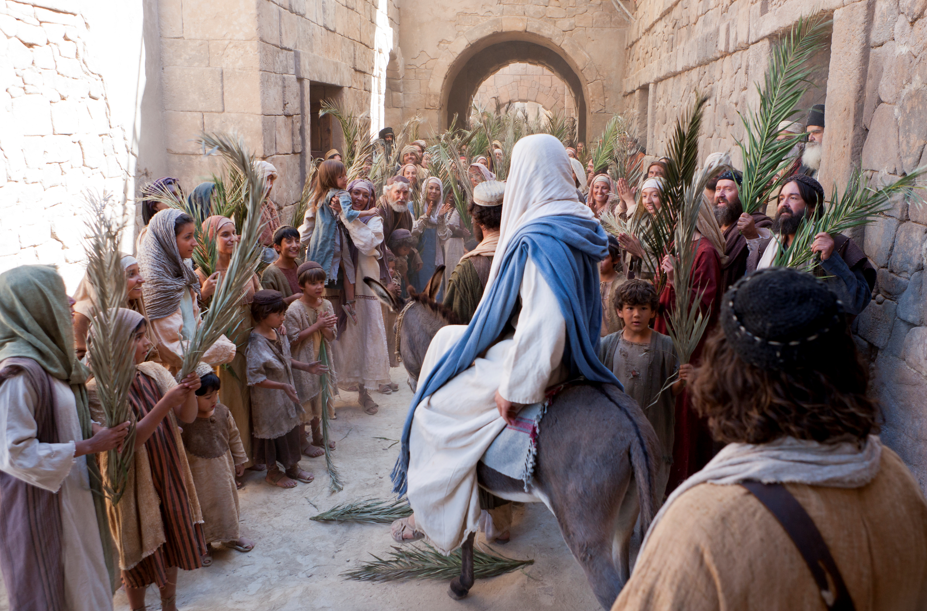
A Heart-Wrenching Good-Bye

