Slide 1
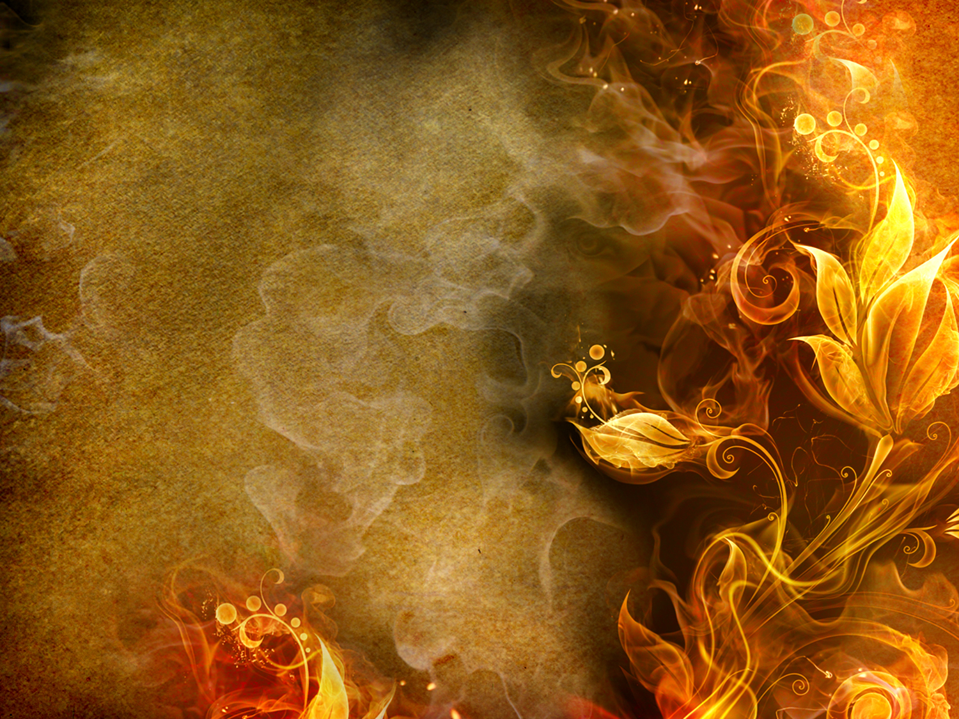

The Fire Will Fall
Where The Wood Is Wet
1 Kings 18:1-39 (NIV)
Sunday, January 25, 2015
Wayne Hartsgrove

Slide 2
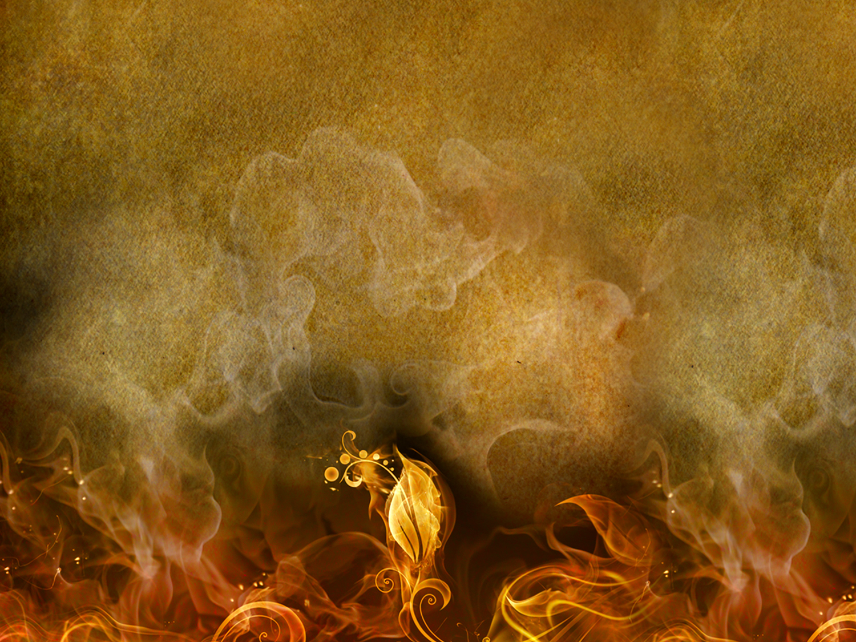
1 Kings 18:1-3 (NIV)
18 After a long time, in the third year, the word of the Lord came to Elijah: “Go and present yourself to Ahab, and I will send rain on the land.” ² So Elijah went to present himself to Ahab.
Now the famine was severe in Samaria, ³ and Ahab had summoned Obadiah, his palace administrator. (Obadiah was a devout believer in the Lord.

Slide 3
1 Kings 18:4-5 (NIV)
⁴ While Jezebel was killing off the Lord’s prophets, Obadiah had taken a hundred prophets and hidden them in two caves, fifty in each, and had supplied them with food and water.) ⁵ Ahab had said to Obadiah, “Go through the land to all the springs and valleys. Maybe we can find some grass to keep the horses and mules alive so we will not have to kill any of our animals.”

Slide 4
1 Kings 18:6-8 (NIV)
⁶ So they divided the land they were to cover, Ahab going in one direction and Obadiah in another.
⁷ As Obadiah was walking along, Elijah met him. Obadiah recognized him, bowed down to the ground, and said, “Is it really you, my lord Elijah?”
⁸ “Yes,” he replied. “Go tell your master, ‘Elijah is here.’”

Slide 5
1 Kings 18:9-11 (NIV)
⁹ “What have I done wrong,” asked Obadiah, “that you are handing your servant over to Ahab to be put to death? ¹⁰ As surely as the Lord your God lives, there is not a nation or kingdom where my master has not sent someone to look for you. And whenever a nation or kingdom claimed you were not there, he made them swear they could not find you. ¹¹ But now you tell me to go to my master and say, ‘Elijah is here.’

Slide 6
1 Kings 18:12-14 (NIV)
¹² I don’t know where the Spirit of the Lord may carry you when I leave you. If I go and tell Ahab and he doesn’t find you, he will kill me. Yet I your servant have worshiped the Lord since my youth. ¹³ Haven’t you heard, my lord, what I did while Jezebel was killing the prophets of the Lord? I hid a hundred of the Lord’s prophets in two caves, fifty in each, and supplied them with food and water. ¹⁴ And now you tell me to go to my master and say, ‘Elijah is here.’ He will kill me!”

Slide 7
1 Kings 18:15 (NIV)
¹⁵ Elijah said, “As the Lord Almighty lives, whom I serve, I will surely present myself to Ahab today.”

Slide 8
1 Kings 18:16-17 (NIV)
¹⁶ So Obadiah went to meet Ahab and told him, and Ahab went to meet Elijah.
¹⁷ When he saw Elijah, he said to him, “Is that you, you troubler of Israel?”

Slide 9
1 Kings 18:18-19 (NIV)
¹⁸ “I have not made trouble for Israel,” Elijah replied. “But you and your father’s family have. You have abandoned the Lord’s commands and have followed the Baals. ¹⁹ Now summon the people from all over Israel to meet me on Mount Carmel. And bring the four hundred and fifty prophets of Baal and the four hundred prophets of Asherah, who eat at Jezebel’s table.”

Slide 10
1 Kings 18:20-21 (NIV)
²⁰ So Ahab sent word throughout all Israel and assembled the prophets on Mount Carmel. ²¹ Elijah went before the people and said, “How long will you waver between two opinions? If the Lord is God, follow him; but if Baal is God, follow him.”
But the people said nothing.

Slide 11
1 Kings 18:22-24 (NIV)
²² Then Elijah said to them, “I am the only one of the Lord’s prophets left, but Baal has four hundred and fifty prophets. ²³ Get two bulls for us. Let Baal’s prophets choose one for themselves, and let them cut it into pieces and put it on the wood but not set fire to it. I will prepare the other bull and put it on the wood but not set fire to it. ²⁴ Then you call on the name of your god, and I will call on the name of the Lord. The god who answers by fire—he is God.”
Then all the people said, “What you say is good.”

Slide 12
1 Kings 18:25-26 (NIV)
²⁵ Elijah said to the prophets of Baal, “Choose one of the bulls and prepare it first, since there are so many of you. Call on the name of your god, but do not light the fire.” ²⁶ So they took the bull given them and prepared it.
Then they called on the name of Baal from morning till noon. “Baal, answer us!” they shouted. But there was no response; no one answered. And they danced around the altar they had made.

Slide 13
1 Kings 18:27-29 (NIV)
²⁷ At noon Elijah began to taunt them. “Shout louder!” he said. “Surely he is a god! Perhaps he is deep in thought, or busy, or traveling. Maybe he is sleeping and must be awakened.” ²⁸ So they shouted louder and slashed themselves with swords and spears, as was their custom, until their blood flowed. ²⁹ Midday passed, and they continued their frantic prophesying until the time for the evening sacrifice. But there was no response, no one answered, no one paid attention.

Slide 14
1 Kings 18:30-33 (NIV)
³⁰ Then Elijah said to all the people, “Come here to me.” They came to him, and he repaired the altar of the Lord, which had been torn down. ³¹ Elijah took twelve stones, one for each of the tribes descended from Jacob, to whom the word of the Lord had come, saying, “Your name shall be Israel.” ³² With the stones he built an altar in the name of the Lord, and he dug a trench around it large enough to hold two seahs of seed. ³³ He arranged the wood, cut the bull into pieces and laid it on the wood. Then he said to them, “Fill four large jars with water and pour it on the offering and on the wood.”

Slide 15
1 Kings 18:34-35 (NIV)
³⁴ “Do it again,” he said, and they did it again.
“Do it a third time,” he ordered, and they did it the third time. ³⁵ The water ran down around the altar and even filled the trench.

Slide 16
1 Kings 18:36-37 (NIV)
³⁶ At the time of sacrifice, the prophet Elijah stepped forward and prayed: “Lord, the God of Abraham, Isaac and Israel, let it be known today that you are God in Israel and that I am your servant and have done all these things at your command. ³⁷ Answer me, Lord, answer me, so these people will know that you, Lord, are God, and that you are turning their hearts back again.”

Slide 17
1 Kings 18:38-39 (NIV)
³⁸ Then the fire of the Lord fell and burned up the sacrifice, the wood, the stones and the soil, and also licked up the water in the trench.
³⁹ When all the people saw this, they fell prostrate and cried, “The Lord—he is God! The Lord—he is God!”

Slide 18
QUESTIONS
&
ANSWERS

Slide 19
1.
Memorize Romans 12:1 on your own.
12 Therefore, I urge you, brothers and sisters, in view of God’s mercy, to offer your bodies as a living sacrifice, holy and pleasing to God—this is your true and proper worship.

Slide 20
2.
Elijah took how many stones
to build the altar?
12

Slide 21
3.
What did these stones represent?
12 tribes of Israel

Slide 22
4.
Were the stones that Elijah used to build the altar designed by any tool?
NO
Why?
Because that would pollute them.

Slide 23
5.
1 Peter 5:5 (ESV)
⁵ Likewise, you who are younger, be subject to the elders. Clothe yourselves, all of you, with humility toward one another, for “God opposes the proud but gives grace to the humble.”

Slide 24
6.
If we really want to experience a move of God in 2015
its going to cost us something.

Slide 25
7.
A fire fell where the wood was wet.

Slide 26
8.
We used to call the altar the mourner’s bench.

Slide 27
9.
Acts 6:4 (KJV)
⁴ But we will give ourselves continually to prayer, and to the ministry of the word.

Slide 28
10.
The supernatural fire of God falls on a praying church.

Slide 29
Romans 12:1 (HCSB)
12 Therefore, brothers, by the mercies of God, I urge you to present your bodies as a living sacrifice, holy and pleasing to God; this is your spiritual worship.

Slide 30
Malachi 3:7 (HCSB)
⁷ “Since the days of your fathers, you have turned from My statutes; you have not kept them. Return to Me, and I will return to you,” says the Lord of Hosts.
But you ask: “How can we return?”

Slide 31
2 Chronicles 7:14 (HCSB)
¹⁴ and My people who are called by My name humble themselves, pray and seek My face, and turn from their evil ways, then I will hear from heaven, forgive their sin, and heal their land.

Slide 32
2 Chronicles 6:26-27 (HCSB)
²⁶ When the skies are shut and there is no rain
because they have sinned against You,
and they pray toward this place
and praise Your name,
and they turn from their sins
because You are afflicting them,
²⁷ may You hear in heaven
and forgive the sin of Your servants
and Your people Israel,
so that You may teach them the good way
they should walk in.
May You send rain on Your land
that You gave Your people for an inheritance.

Slide 33
Exodus 20:25 (AMP)
²⁵ And if you will make Me an altar of stone, you shall not build it of hewn stone, for if you lift up a tool upon it you have polluted it.

Slide 34
Exodus 30:32 (AMP)
³² It shall not be poured upon a layman’s body, nor shall you make any other like it in composition; it is holy, and you shall hold it sacred.

Slide 35
1 Peter 5:5 (HCSB)
⁵ In the same way, you younger men, be subject to the elders. And all of you clothe yourselves with humility toward one another, because
God resists the proud
but gives grace to the humble.

Slide 36
Psalm 51:17 (HCSB)
¹⁷ The sacrifice pleasing to God is a broken spirit.
God, You will not despise a broken and humbled heart.

Slide 37
Acts 6:4 (HCSB)
⁴ But we will devote ourselves to prayer and to the preaching ministry.”

Slide 38
Ezekiel 47:1-2 (NIV)
47 The man brought me back to the entrance to the temple, and I saw water coming out from under the threshold of the temple toward the east (for the temple faced east). The water was coming down from under the south side of the temple, south of the altar. ² He then brought me out through the north gate and led me around the outside to the outer gate facing east, and the water was trickling from the south side.

Slide 39
Ezekiel 47:3-5 (NIV)
³ As the man went eastward with a measuring line in his hand, he measured off a thousand cubits and then led me through water that was ankle-deep. ⁴ He measured off another thousand cubits and led me through water that was knee-deep. He measured off another thousand and led me through water that was up to the waist. ⁵ He measured off another thousand, but now it was a river that I could not cross, because the water had risen and was deep enough to swim in—a river that no one could cross.

Slide 40
Ezekiel 47:9 (NIV)
⁹ Swarms of living creatures will live wherever the river flows. There will be large numbers of fish, because this water flows there and makes the salt water fresh; so where the river flows everything will live.

Slide 41
Ezekiel 47:12 (NIV)
¹² Fruit trees of all kinds will grow on both banks of the river. Their leaves will not wither, nor will their fruit fail. Every month they will bear fruit, because the water from the sanctuary flows to them. Their fruit will serve for food and their leaves for healing.”

Slide 42

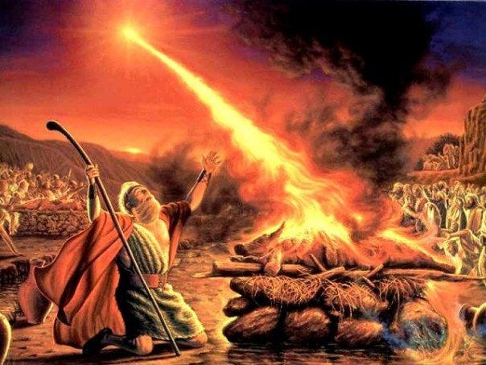
The Fire Will Fall
Where The Wood Is Wet
1 Kings 18:1-39 (NIV)

